Slide 1

P1 Assignment: Dimensional Modeling
Submitted By:
Lakshmi Sravya Dama
Sudeshna Mullaguru
Nikhil Namani
Vinaya Rajaram Nayak
Gayathri Shanmuga Sundaram

Slide 2
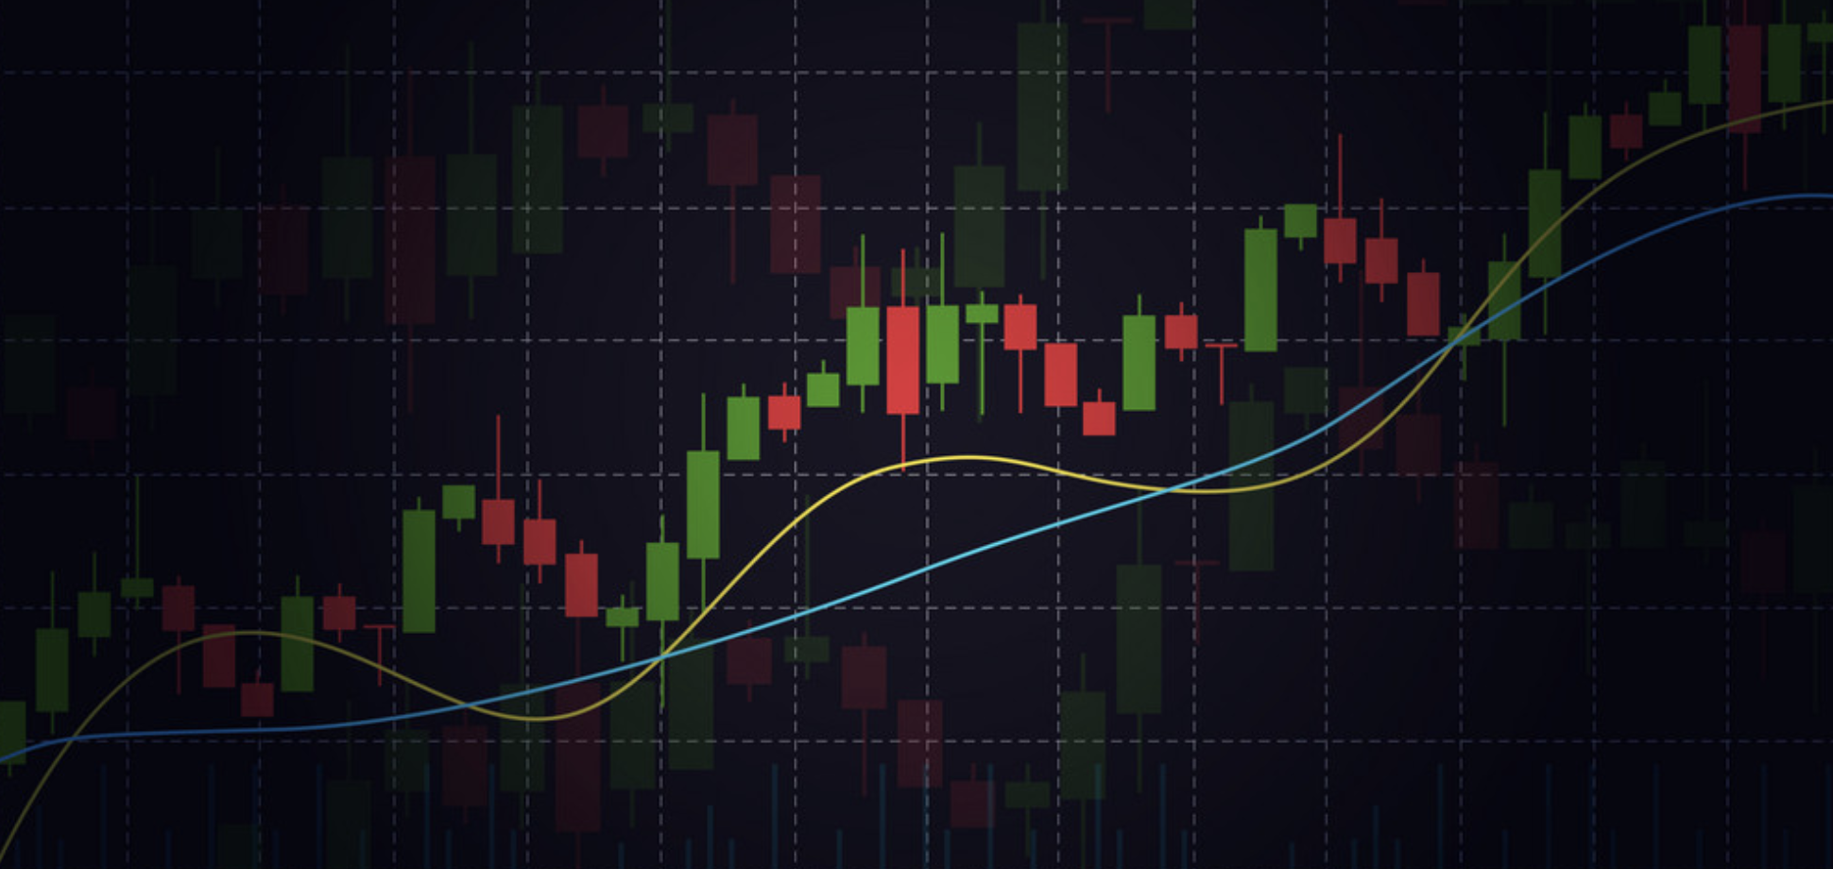
PART A
Dimensional Design for Stock Market Data

Slide 3
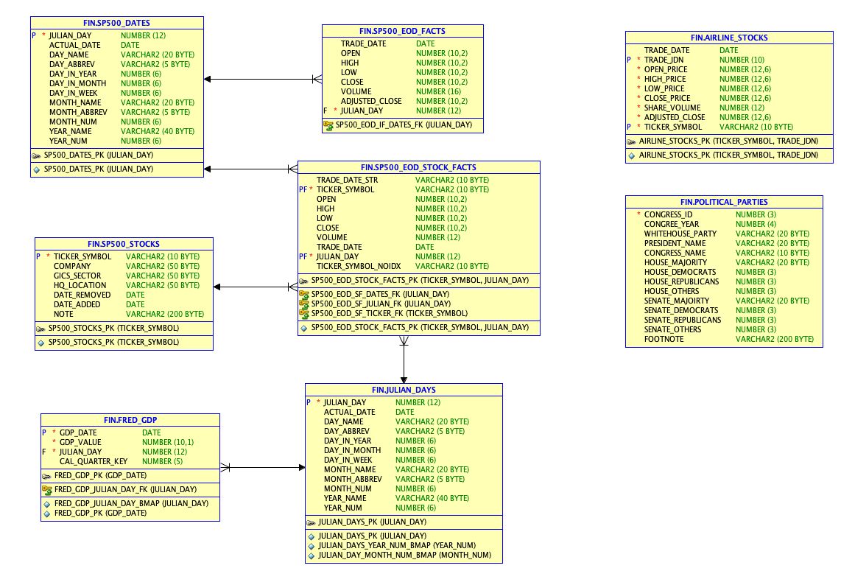
ER Diagram

Slide 4

FACT TABLES:
A fact table is a storage structure that holds numerical data for analysis and is commonly designed in a denormalized manner.
It interacts with dimension tables, which contain information about various ways to analyze the data stored in the fact table
Essentially, the fact table contains the data to be analyzed, while the dimension table stores details about how that data can be examined.

Slide 5
Fact Tables in ERD
SP500_EOD_FACTS
SP500_EOD_STOCKS_FACTS
AIRLINE_STOCKS
FRED_GDP

Slide 6

Dimension Table in ERD
JULIAN_DAYS
SP500_STOCKS
SP500_DATES
POLITICAL_PARTIES

Slide 7

How would you extend the design to handle complexities like stock splits (or reverse stock splits), mergers and acquisitions, or changes in business itself such as new sectors?
To record events like stock splits and reverse stock splits, we can create a dimension table called "Stock Events". This table will include details like the type of event, the date it occurred, the stock symbol that was impacted, and the variable that affected the stock price.
Using the stock symbol and event date, relationships can be created between the SP500_STOCKS dimension, SP500_EOD_STOCK_FACTS fact table, and the Stock Events dimension.

Slide 8

2. You are also free to extend the project by adding any additional data For example, the POLITICAL_PARTIES table is already available and would support analyses that looked at the possible effects of government (such as single-party or divided government).
We have added the POLITICAL_PARTIES table. In our context we are using it as a dimension table as it has descriptive information about congressional sessions, parties, and members.

Slide 9
3. In addition to the design diagrams, your project should include a few queries of interest that could be run against your data warehouse. You should include a description of the query, the SQL, and an example output (you can just make up the data if necessary).
Next slides include the queries

Slide 10

Query 1: AVERAGE VOLUME OF STOCK TRADED PER MONTH
SELECT j.month_name , s.ticker_symbol, round(avg(volume),2) as avg_volume FROM fin.sp500_eod_stock_facts s inner join fin.julian_days j on s.julian_day=j.julian_day group by j.month_name , s.ticker_symbol ;

Slide 11
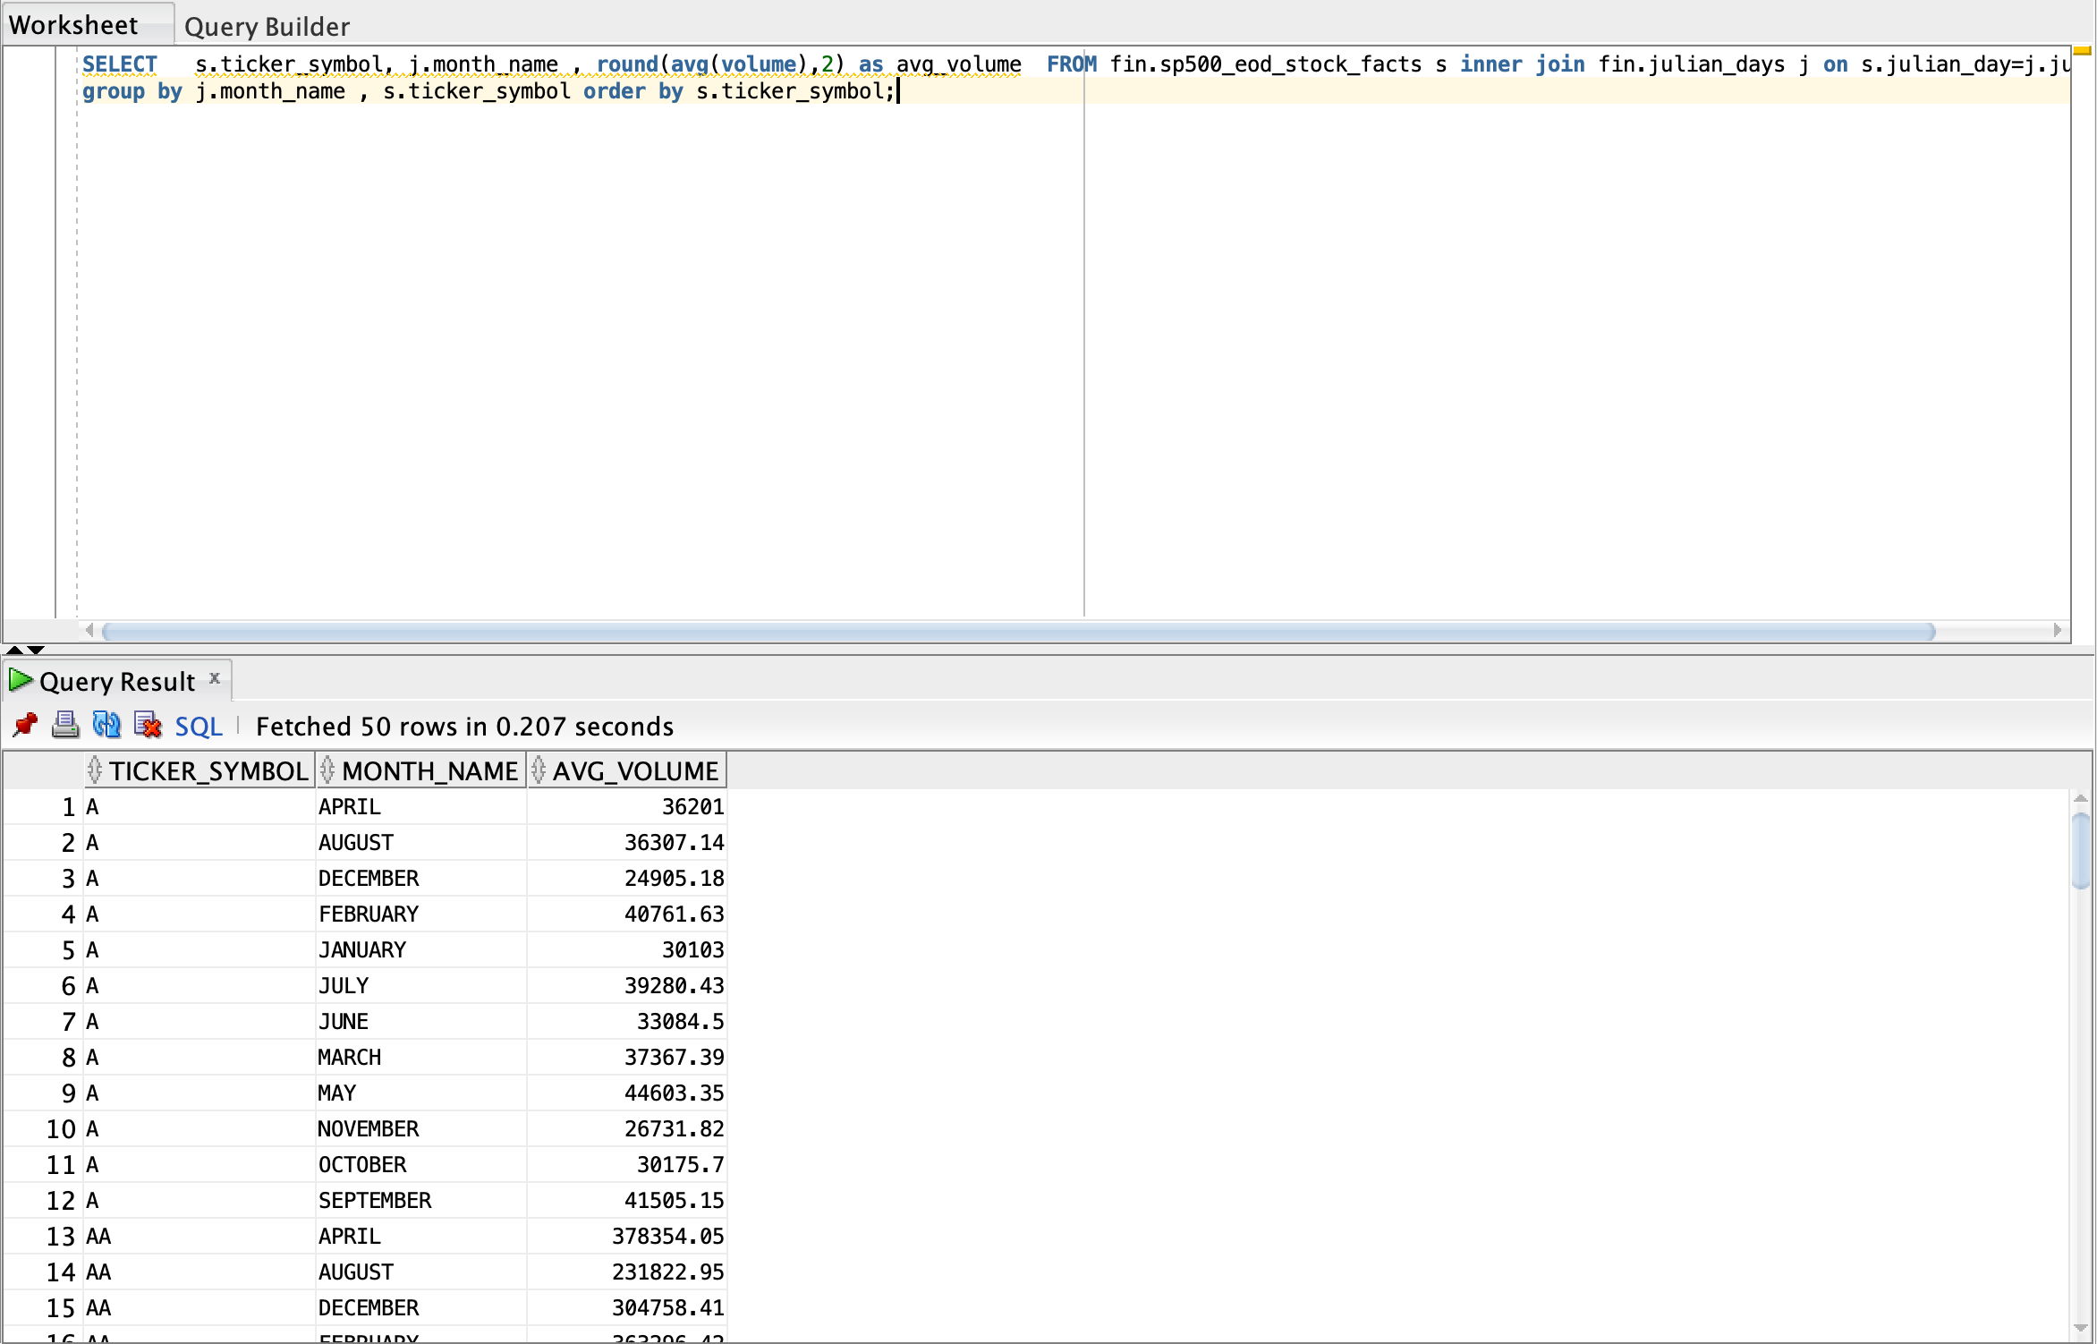

Slide 12

Query 2 : Stock Price Daily Performance in S&P 500 Companies
select trade_date, s.ticker_symbol,company,open,close, case when close > open then 'green' else 'red' end as indicator from fin.sp500_eod_stock_facts s inner join fin.sp500_stocks ss on s.ticker_symbol=ss.ticker_symbol order by s.ticker_symbol;

Slide 13
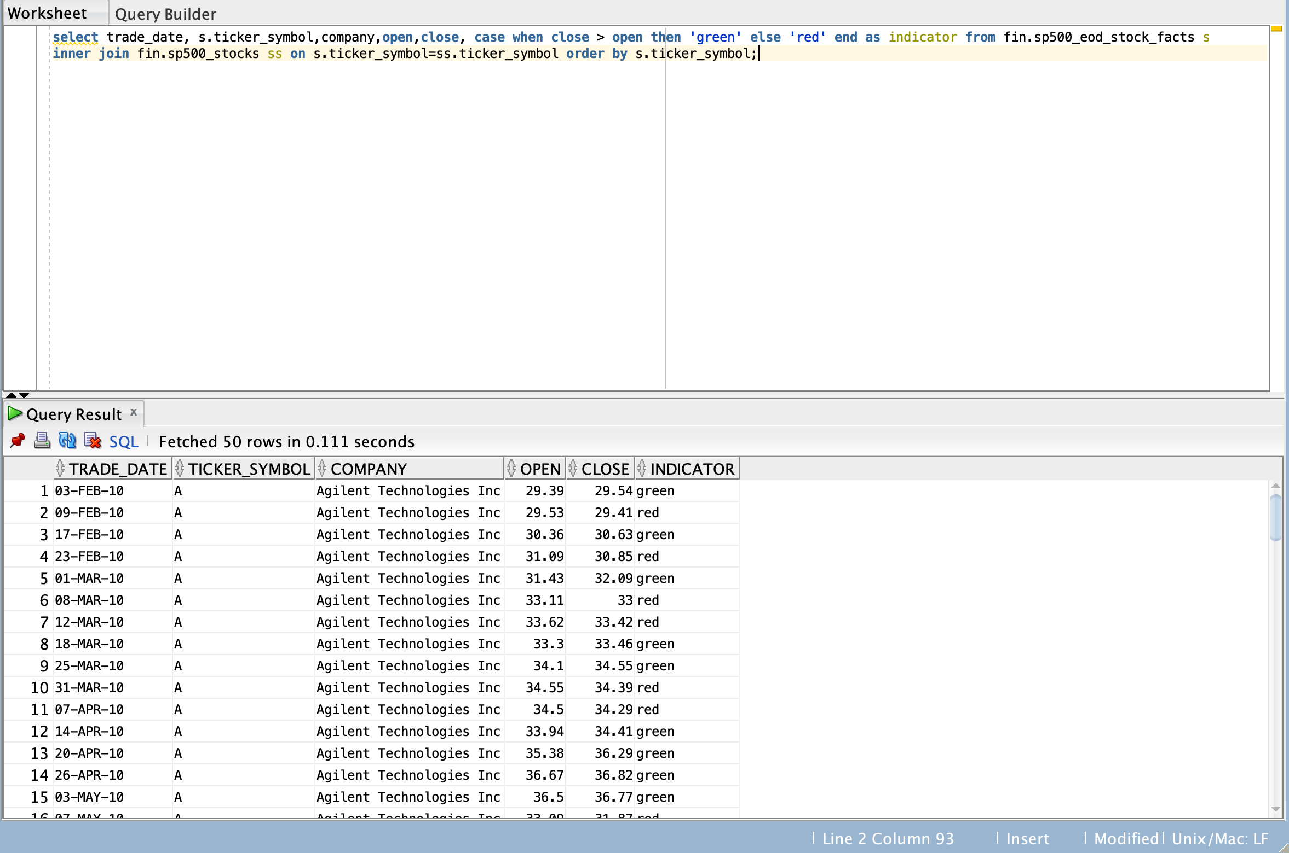

Slide 14

Query 3: Top 10 Years with Highest Average GDP Value During Presidential Terms
with cte as(select round(avg(gdp_value),2) as avg_gdp ,year_num from fin.fred_gdp f inner join fin.julian_days j on f.julian_day=j.julian_day group by year_num) select president_name,avg_gdp,year_num from cte c inner join fin.political_parties p on c.year_num=p.congree_year order by avg_gdp desc FETCH FIRST 10 ROWS ONLY;

Slide 15
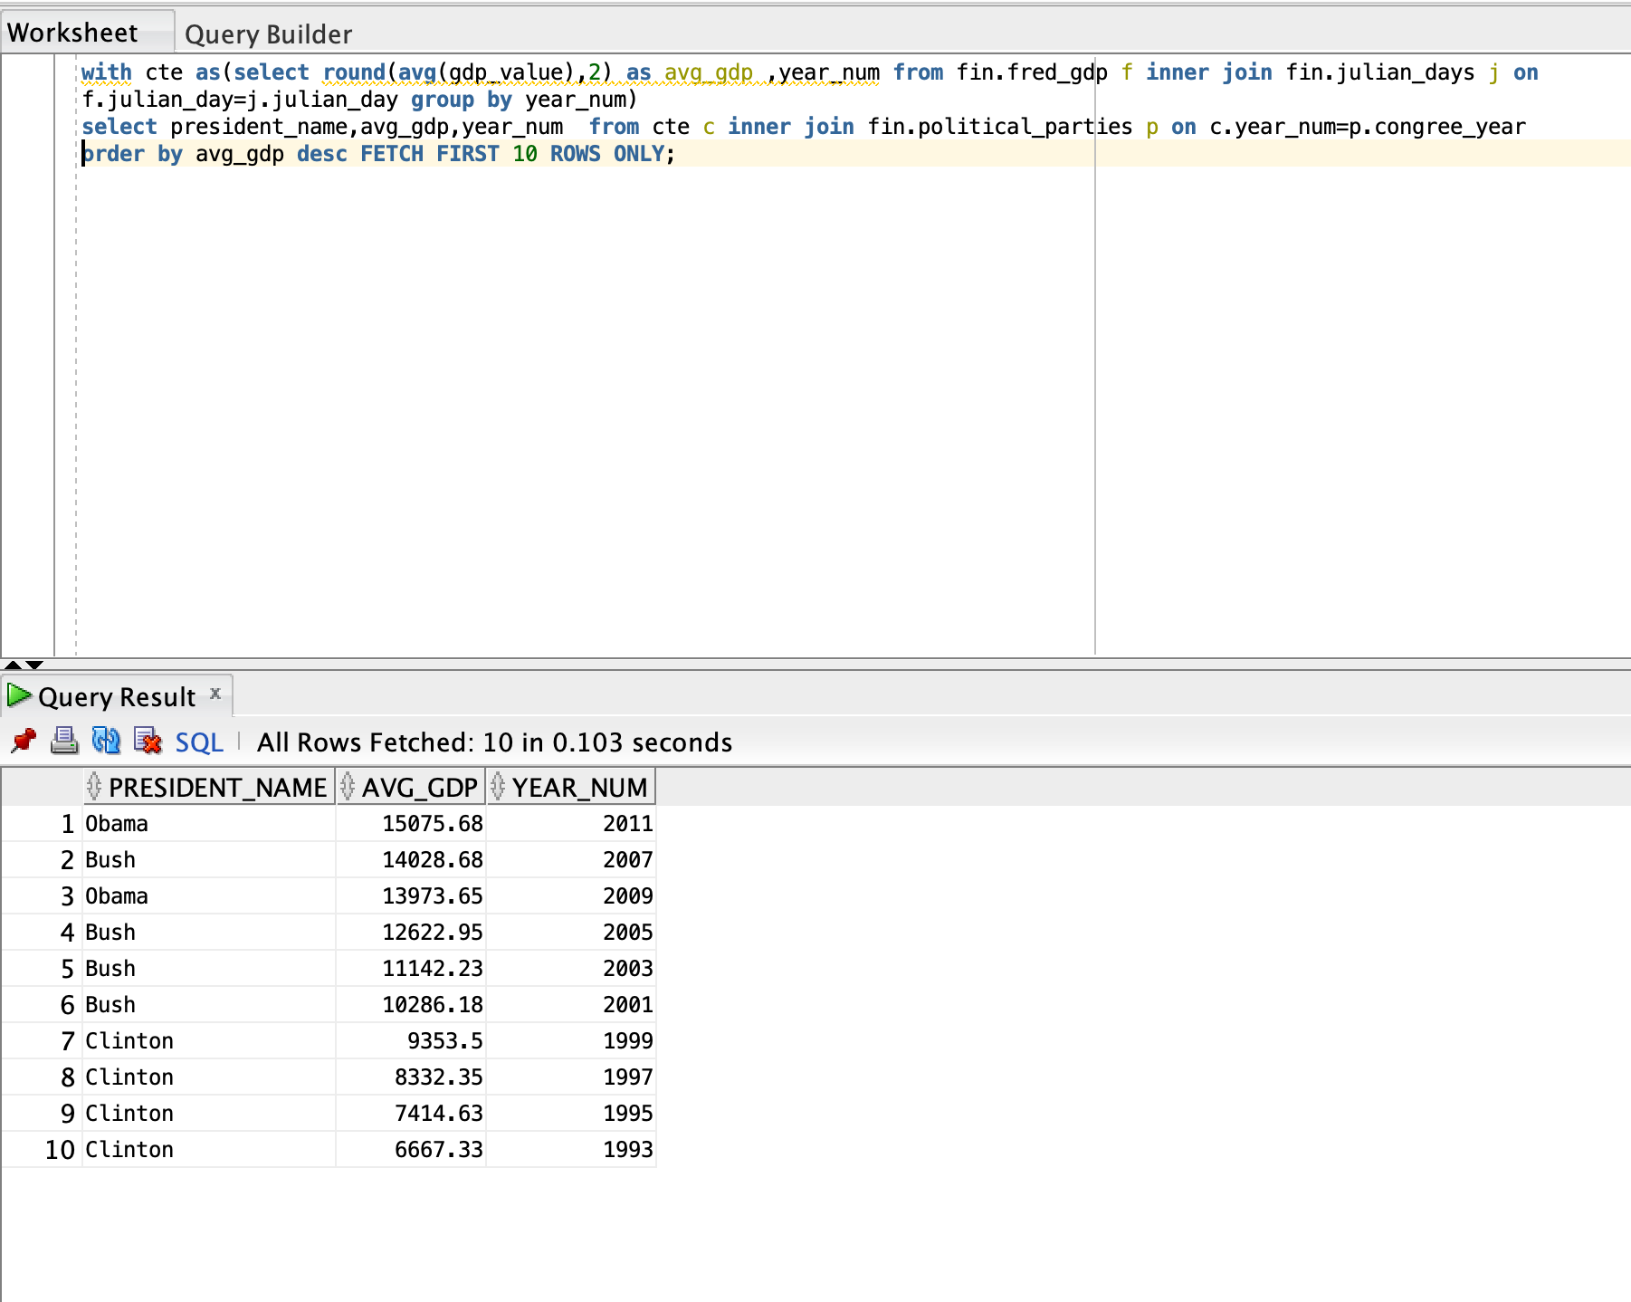

Slide 16

Query 4 Top Trading Companies in the S&P 500
WITH volume_tr AS (SELECT s.company, v1.ticker_symbol, v1.volume_traded FROM
(SELECT ticker_symbol, sum(volume) AS volume_traded FROM FIN.sp500_eod_stock_facts GROUP BY ticker_symbol ORDER BY volume_traded DESC) v1 INNER JOIN fin.sp500_stocks s ON v1.ticker_symbol = s.ticker_symbol ORDER BY s.company ASC) select company,ticker_symbol,volume_traded, rank() over (order by volume_traded desc) as vol_rank from volume_tr

Slide 17
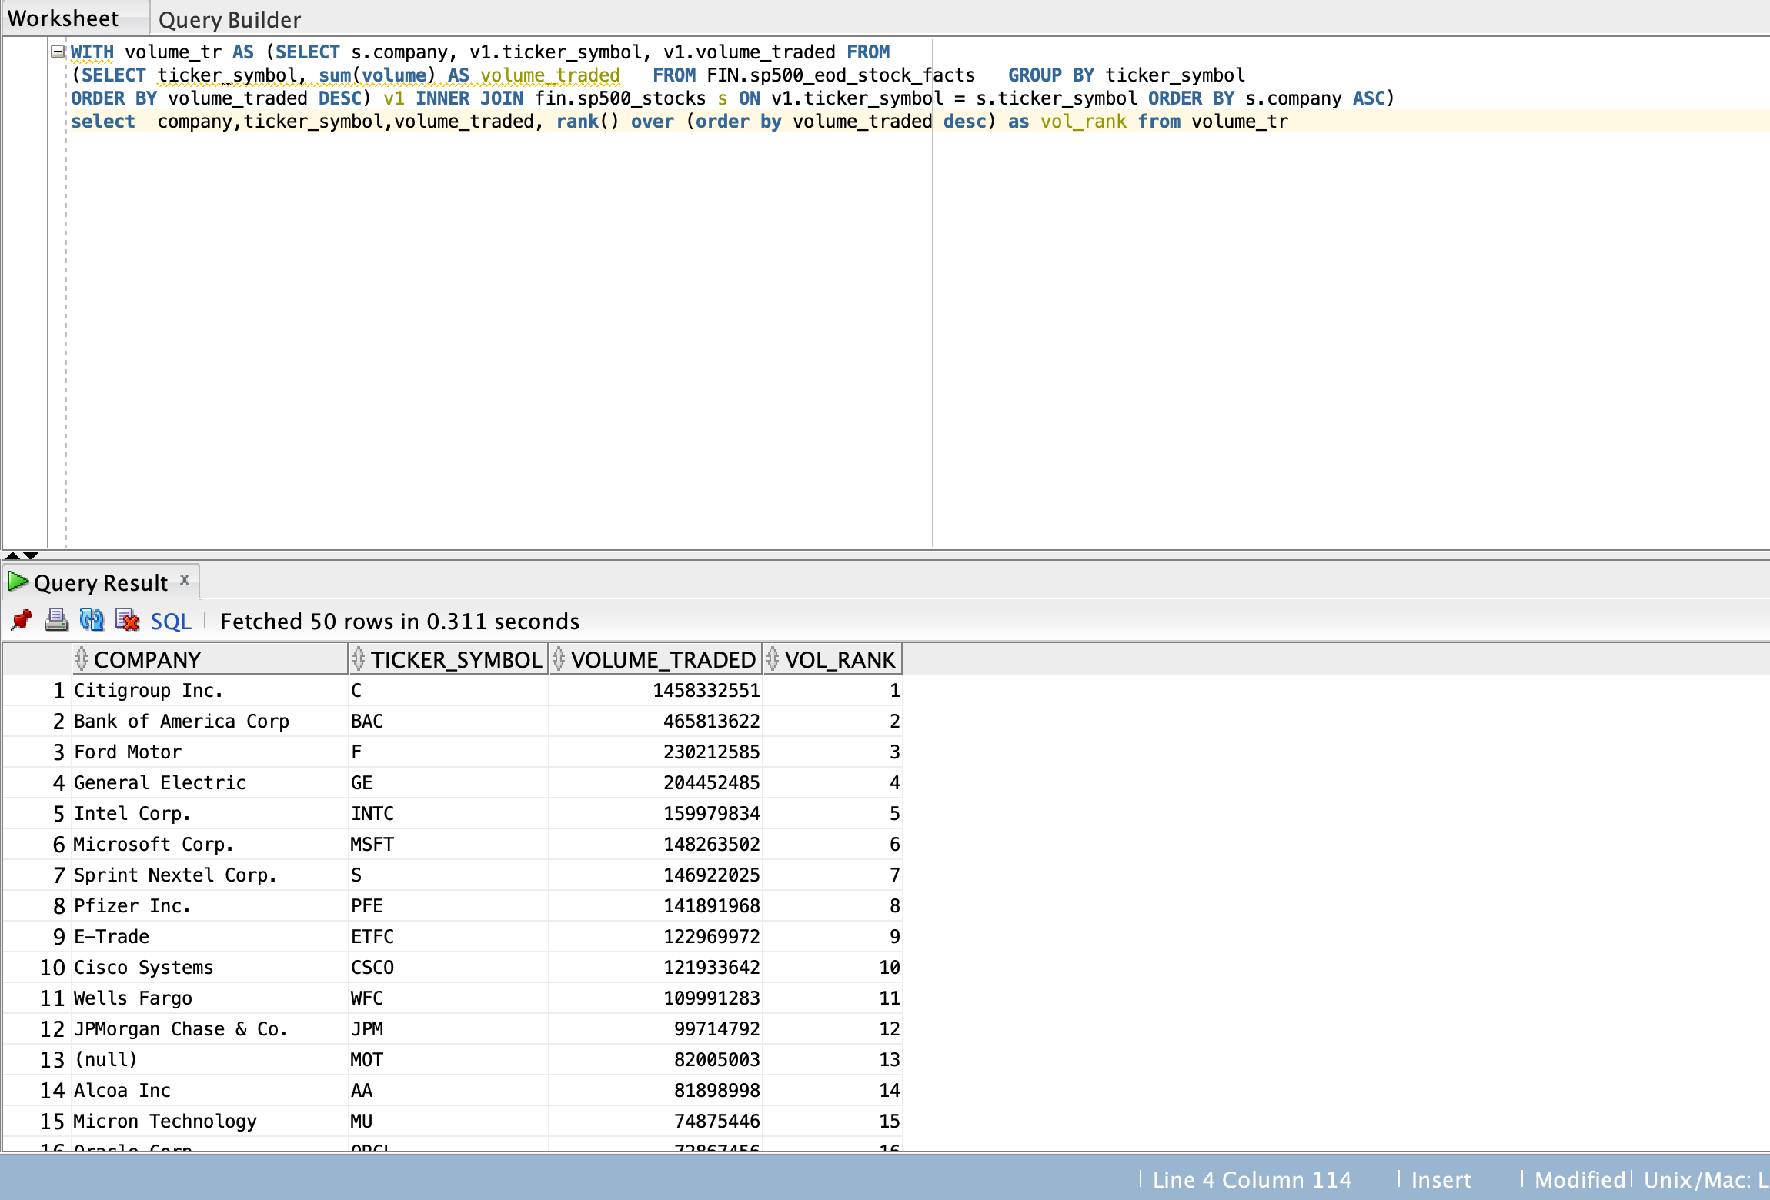

Slide 18

Query 5 Average Daily Closing Prices of Airline Stocks (2000-2023) - Exceeding $50
select ticker_symbol, TO_CHAR(trade_date, 'YYYY-MM-DD') AS trade_date, AVG(adjusted_close) AS avg_closing_price from fin.airline_stocks where trade_date between TO_DATE('2000-01-01', 'YYYY-MM-DD') and TO_DATE('2023-12-31', 'YYYY-MM-DD') group by ticker_symbol, TO_CHAR(trade_date, 'YYYY-MM-DD') having AVG(adjusted_close) > 50 order by ticker_symbol, trade_date;

Slide 19
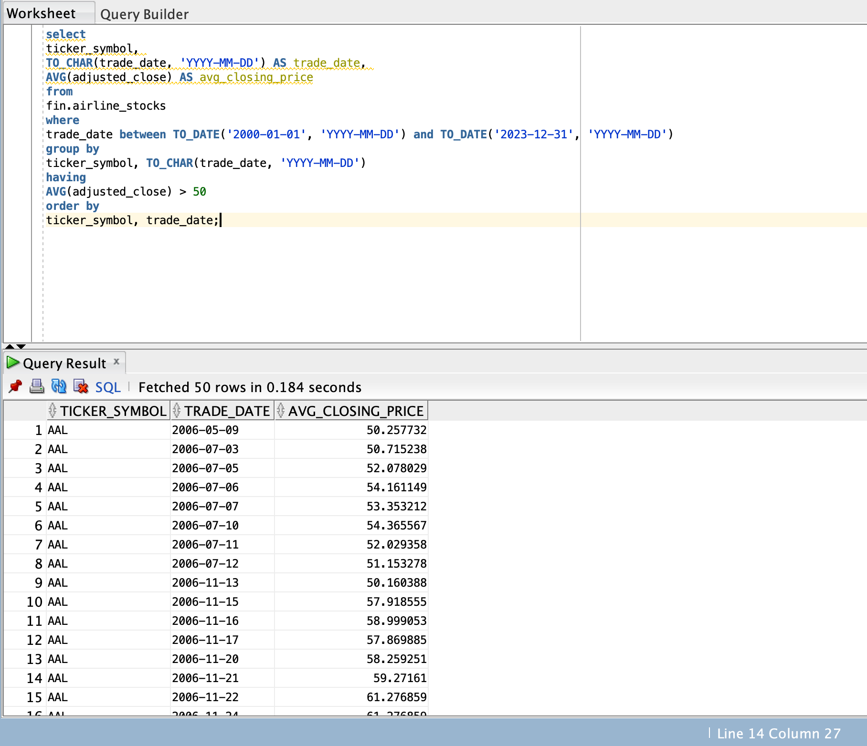

Slide 20

Part B:Crime Analysis

Slide 21

Dimensional model for Crime Analysis:
In this part, we will be analyzing the data related to Crime Records in different states which is part of the Portfolio Project.
In this we will be doing exploratory analysis, and we will find the crime rates according to the state.
Tentatively, we have 5 tables in this model and later all possible tables will be added in the final project.

Slide 22
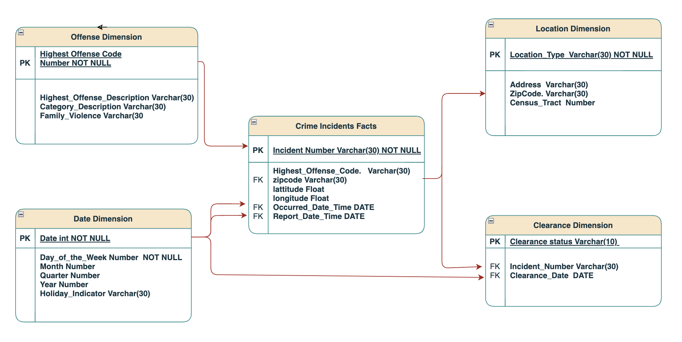
ER Diagram

Slide 23

THANK YOU

